Slide 1
GitHub and Digital Repository Management
Final Project
https://drive.google.com/drive/folders/11xmX-SpC7FCqFMpnRASH0tSGG0Kl23f-?usp=sharing

Slide 4
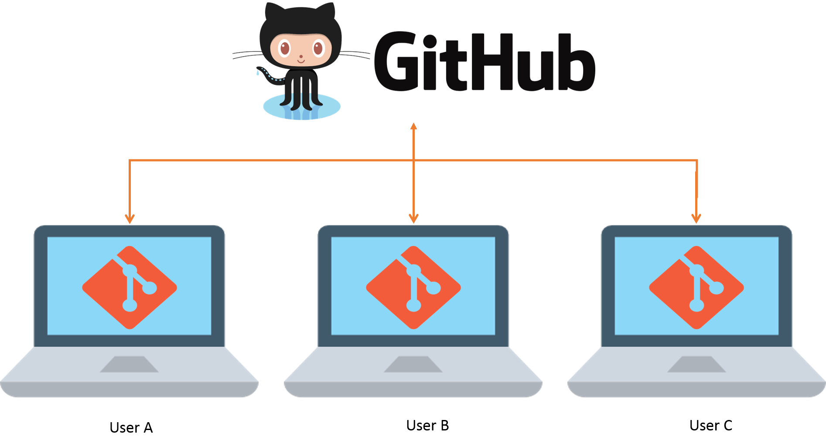
GitHub
GitHub is a platform for hosting code that allows for version control and collaboration. It allows you and others to collaborate on projects from anywhere.

Slide 5
• GitHub Account Creation
• Git Installation
• SSH Key Generation and Configuration
• Repository Creation & Project Upload
• New Branch Creation
• Pull Request (PR) Creation & Approval
• Conflict Between Branches
• Conflict Resolution Process
• Revert Changes with Git Commands
• Approved PRs and Merged Branches

Slide 6
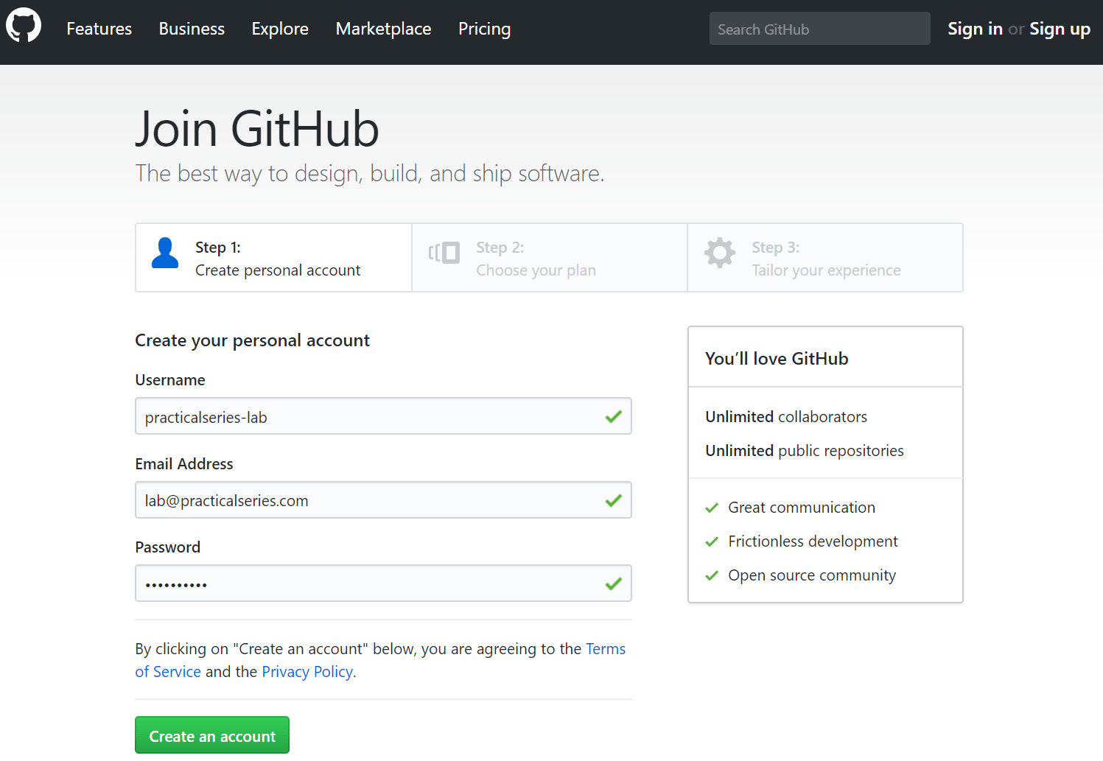
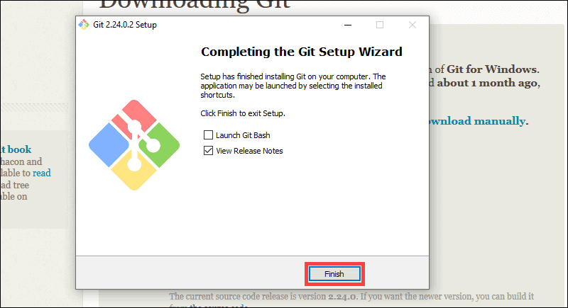
Git creation and Installation.

Slide 7
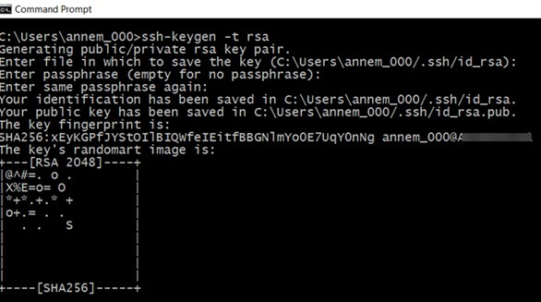

Ssh configuration and Repository creation

Slide 8
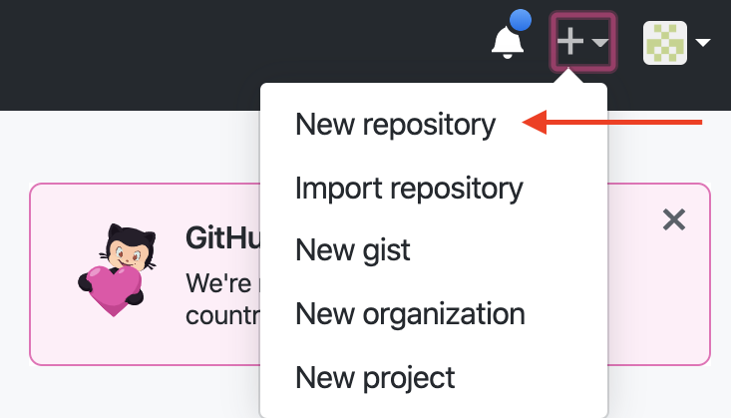
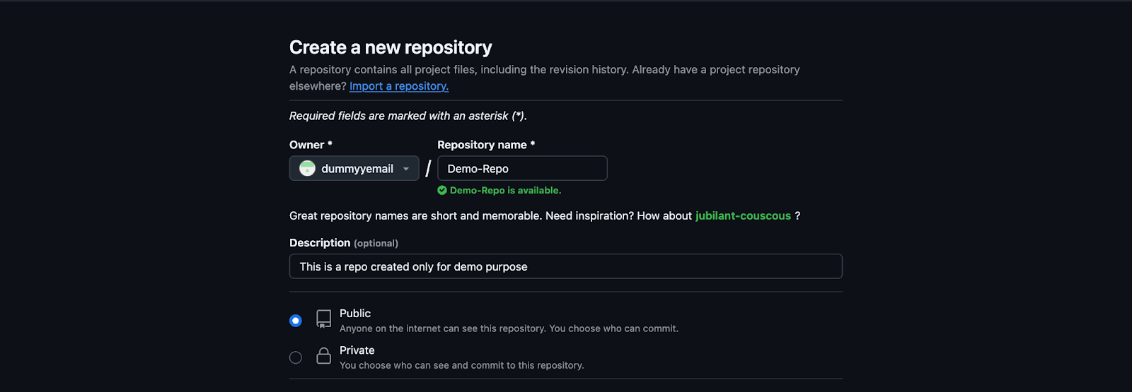
Repository Creation & Project Upload

Slide 9
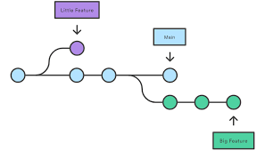
NEW BRANCH CREATION

Slide 10
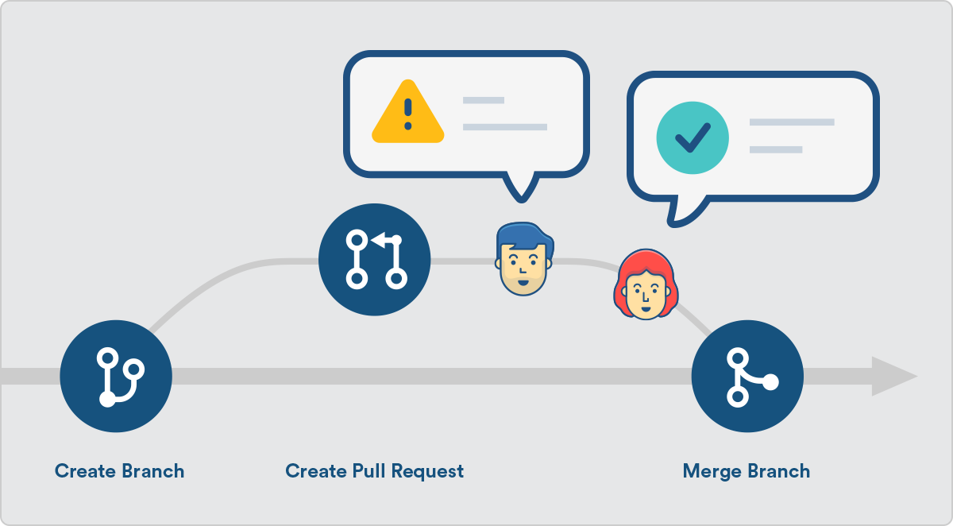
PULL REQUESTS (CREATION AND APPROVAL)

Slide 11
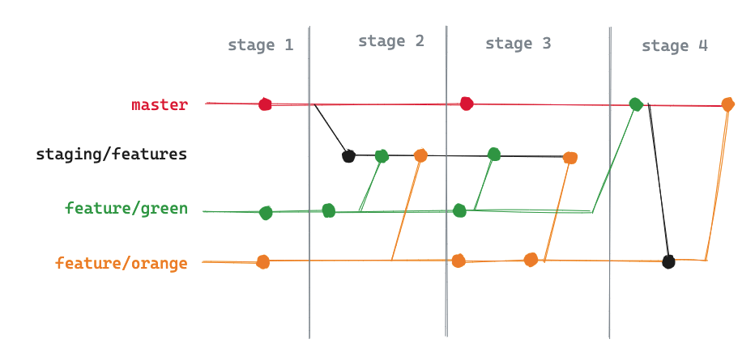
Conflicts between branches

Slide 12
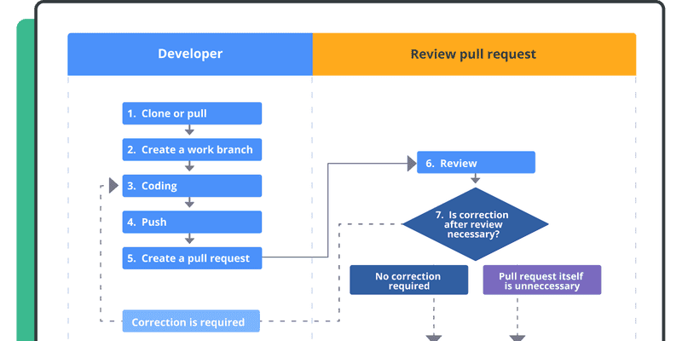
Resolution and pr approvals

